Slide 1
Create your own
platform reference architecture
https://platformengineering.org/platform-tooling

Slide 2
How to use this template
Make a copy of this document
Create your own platform reference architecture
Share it with the community on Platform Engineering Slack

Slide 3









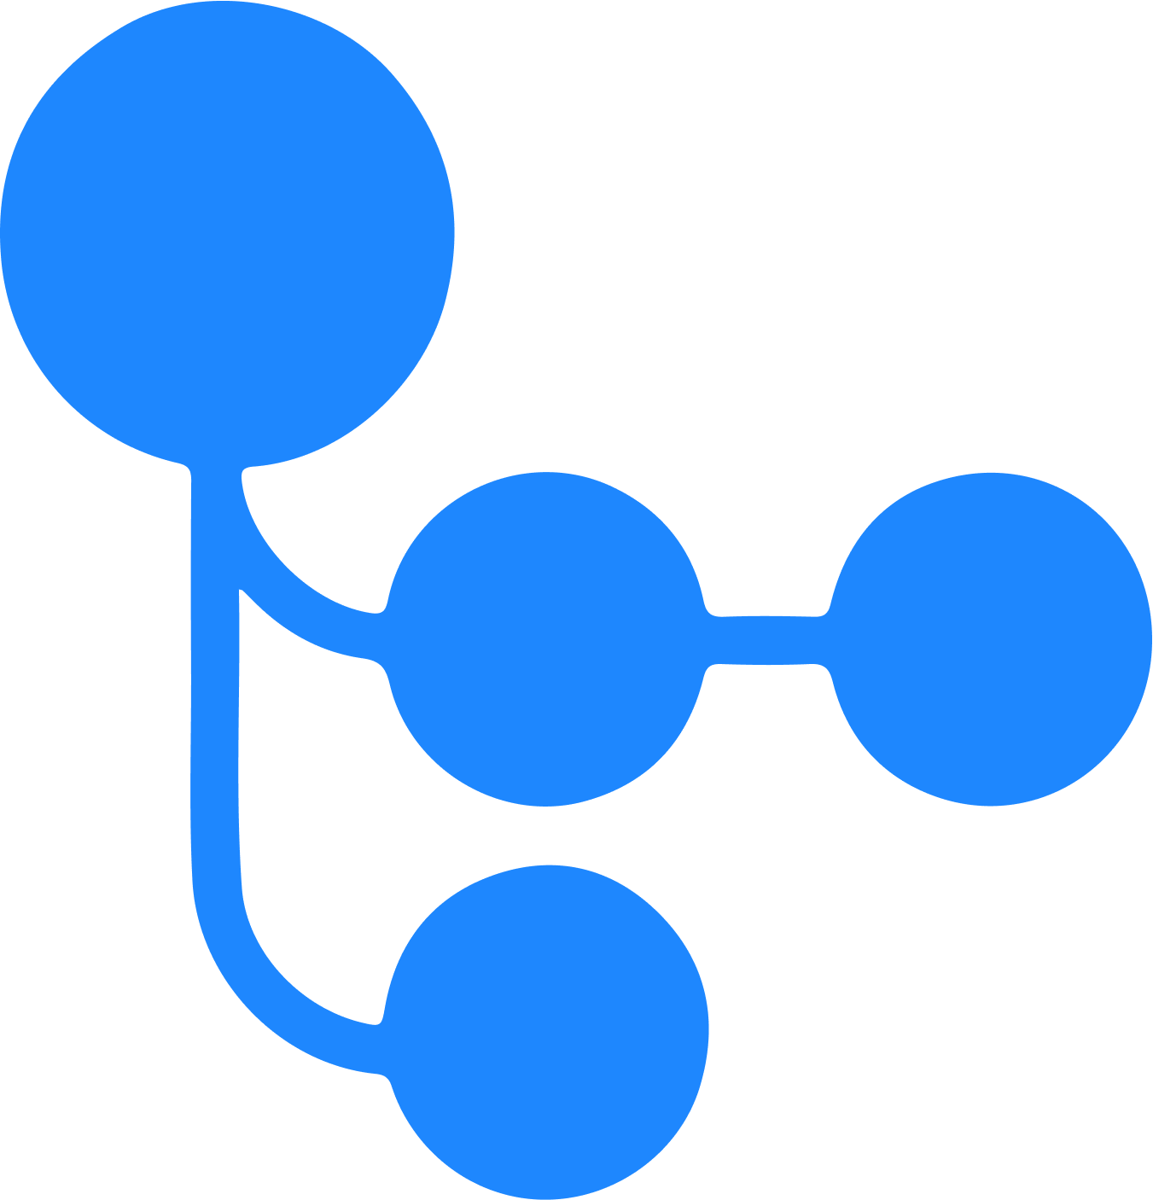


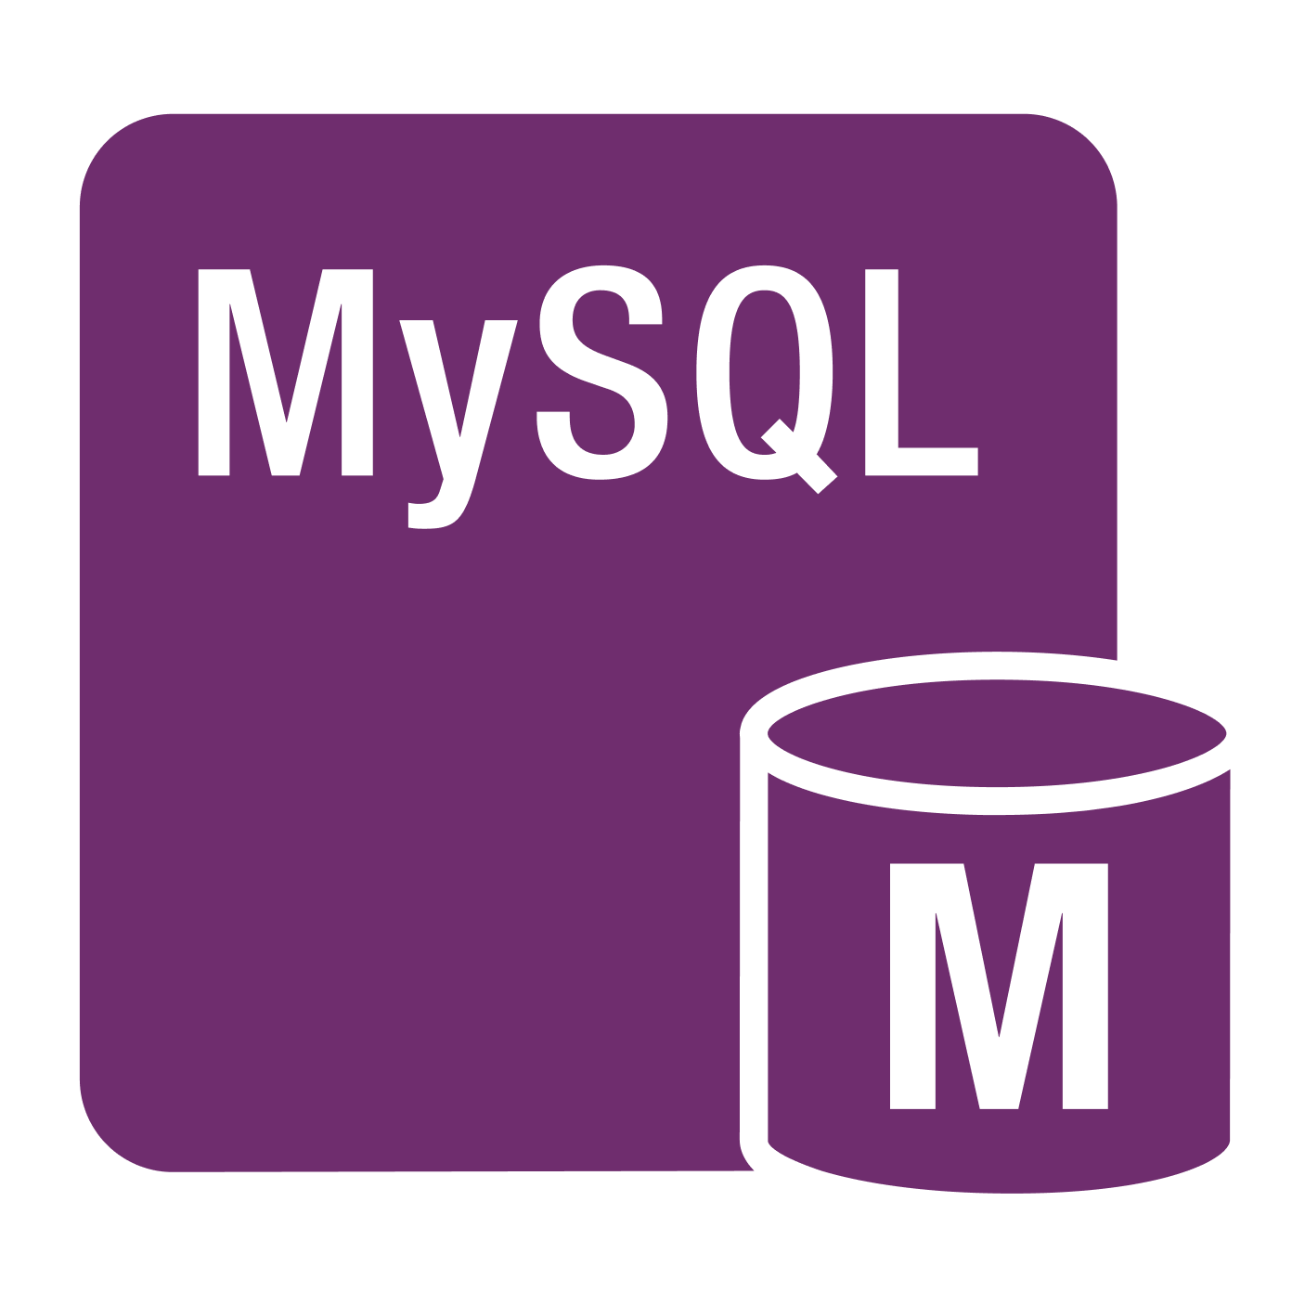




Internal Developer Platform on AWS Cloud
IDE
Service Catalog / API Catalog Developer Portal
Backstage
Developer Control Plane
Version control
Application Source Code
Platform Source Code
GitHub
Score
Workloads
Terraform
Automations
CI Pipeline
Registry
CD Pipeline
Resource Plane
Compute
Integration and
Delivery Plane
Amazon EKS
GitHub Actions
Amazon ECR
Platform Orchestrator
Argo CD
Data
RSD MySQL
Networking
Monitoring and
Logging Plane
Observability
Amazon Cloud Watch
Route 53
Services
Security Plane
Secrets & Identity Manager
Amazon SQS
HCP Vault

Slide 4

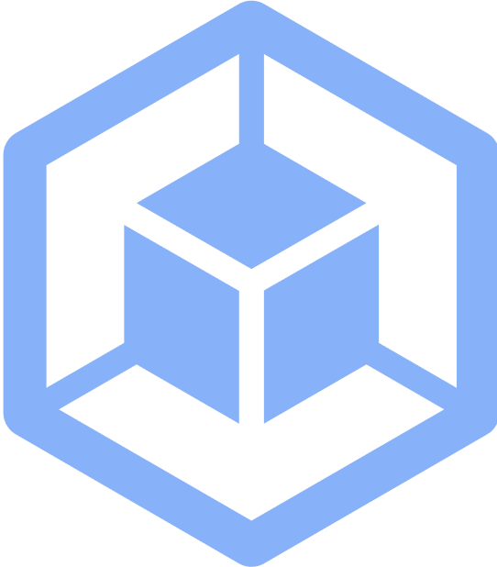
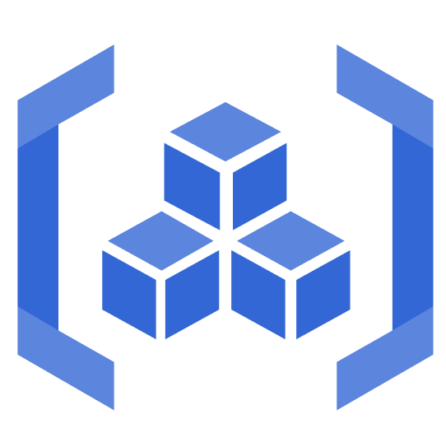





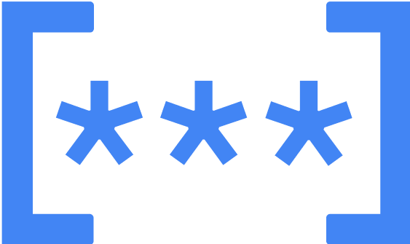
Internal Developer Platform on Google Cloud
Service Catalog / API Catalog Developer Portal
Backstage
Developer Control Plane
IDE
Version Control
Application
Source Code
Platform Source Code
GitHub
Score
Workloads
Terraform
Automations
Resource Plane
Integration and
Delivery Plane
CI Pipeline
Registry
CD Pipeline
Compute
GitHub Actions
Artifact Registry
Argo CD
Kubernetes Engine
Amazon ECR
Platform Orchestrator
Humanitec Deploy
Data
Cloud SQL
Monitoring and
Logging Plane
Networking
Observability
Observability
Cloud DNS
Cloud Monitoring
Cloud Logging
Security Plane
Services
Secrets & Identity Manager
PubSub
Cloud Key Management Service

Slide 5
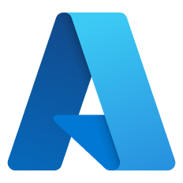
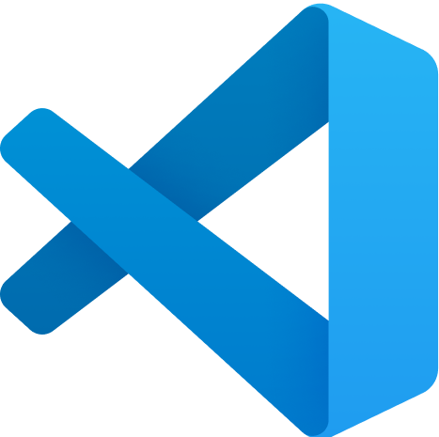
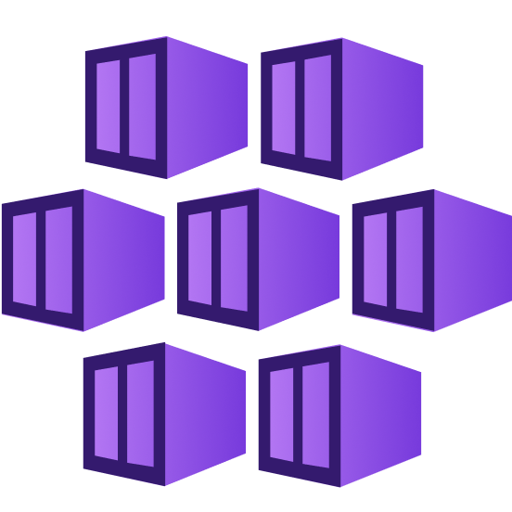
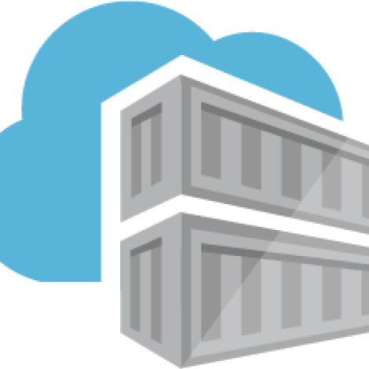

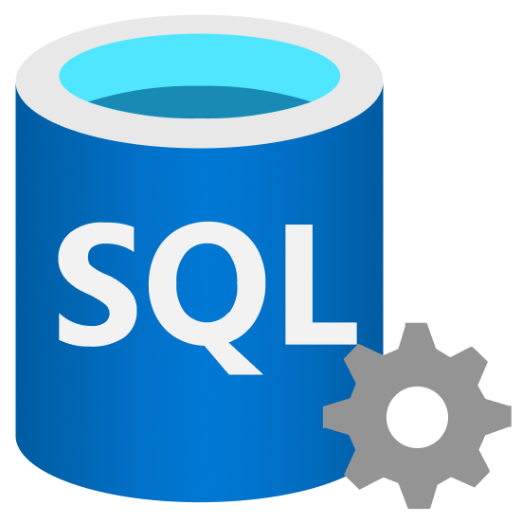
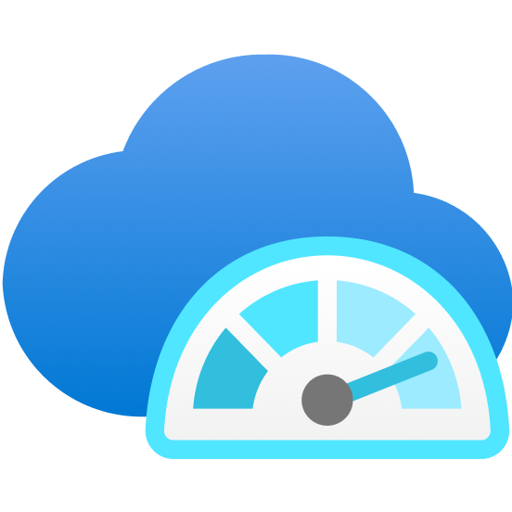

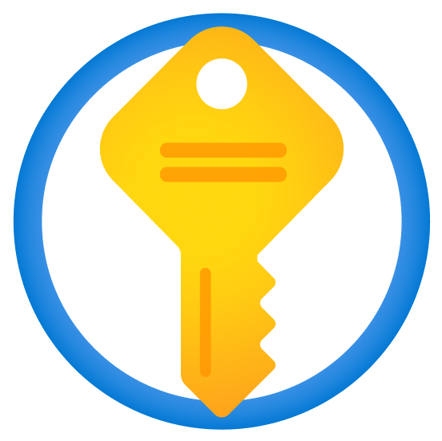

Internal Developer Platform on Azure Cloud
IDE
Service Catalog / API Catalog Developer Portal
Backstage
Developer Control Plane
Version control
Visual Studio Code
Application Source Code
Platform Source Code
GitHub
Score
Workloads
Terraform
Automations
CI Pipeline
Registry
CD Pipeline
Resource Plane
Compute
Integration and
Delivery Plane
Azure Kubernetes Service
GitHub Actions
Azure
Container
Registry
Platform Orchestrator
FluxCD
Data
Azure SQL
Networking
Monitoring and
Logging Plane
Observability
Azure Monitor
Azure DNS
Services
Security Plane
Secrets & Identity Manager
Azure Key Vault
Azure Service Bus

Slide 6












Internal Developer Platform on Openshift
IDE
Service Catalog / API Catalog Developer Portal
Red Hat Developer Hub
Developer Control Plane
Version control
Visual Studio Code
Application Source Code
Platform Source Code
GitHub
Score
Workloads
Terraform
Automations
CI Pipeline
Registry
Resource Plane
Compute
Integration and
Delivery Plane
Target State
Repo
ArgoCD
OS ContainerPlatform (OCP)
Github
Actions
Amazon ECR
Platform Orchestrator
Data
OS Operator Hub
In-cluster Redis Resource Pack
Networking
Monitoring and
Logging Plane
Observability
OS SDN
HAProxy
CoreDNS
Prometheus
Grafana
Services
Security Plane
Secrets & Identity Manager
Streaming
Messaging
Vault
Keycloak
Amazon
Secrets Manager
Kafka
RabbitMQ

Slide 7
Internal Developer Platform on Multi-cloud
IDE
Service Catalog / API Catalog Developer Portal
Resource Plane Cloud Estate A
Resource Plane Cloud Estate B
Backstage
Compute
Compute
Developer Control Plane
Version control
Amazon EKS
Kubernetes Engine
Application Source Code
Platform Source Code
GitHub
Data
Data
Score
Workloads
Terraform
Automations
RSD MySQL
Cloud SQL
CI Pipeline
Registry
CD Pipeline
Networking
Networking
Route 53
Cloud DNS
Integration and
Delivery Plane
Services
Services
GitHub Actions
Amazon ECR
Platform Orchestrator
Humanitec Pipelines
Amazon SQS
PubSub
Gateway
Monitoring and
Logging Plane
Observability
Amazon Cloud Watch
Security Plane
Secrets & Identity Manager
HCP Vault

Slide 8


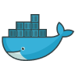


































Platform tools
Developer Control Plane
Integration & Delivery Plane
IDE
Version Control
CI Pipeline
Image Registry
CD
Visual Studio Code
GitHub
GitHub Actions
Docker Hub
ArgoCD
Developer Portal
Bitbucket
Circle CI
Harbor
Humanitec Pipelines
Backstage
GitLab
GitLab CI
JFrog Artifactory
Codefresh
Jenkins
Azure Container Registry
GitHub Actions
Atlassian Compass
App Source Code / Workload Specification
Travis CI
Google Artifact Registry
GitLab CD
Configur8
Cycloid
Score
Azure DevOps
AWS ECR Registry
Flux CD
LeanIX
Google Cloud Build
Quay
Octopus Deploy
Port
Platform Source Code / Infrastructure as Code (IaC)
Platform Orchestrator
Infrastructure Control Plane
OpsLevel
Humanitec Platform Orchestrator
Terraform
Atlantis
Cortex
Crossplane
Kratix
Spacelift
Humanitec Portal
OpenTofu
KusionStack
Terramate
Red Hat Developer Hub
Radius

Slide 9



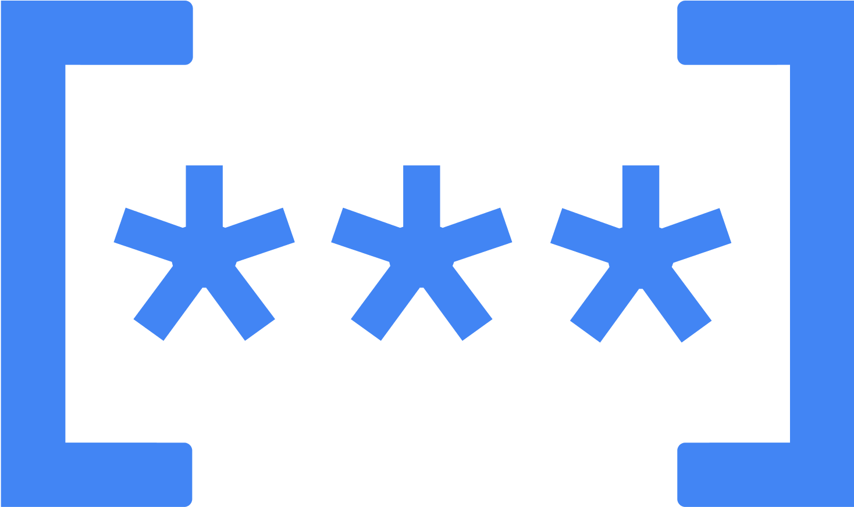



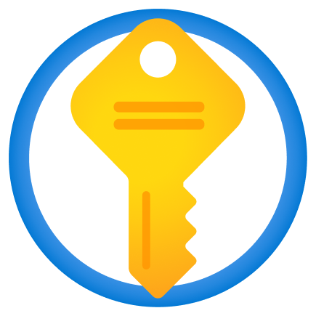



















Platform tools
Monitoring & Logging Plane
Security Plane
Secrets Management
Security
Observability
HCP Vault
Tigera
Styra
Datadog
Google Secrets Manager
Snyk
Azure Sentinel
Fluentbit
Azure Key Vault
Gremlin
Nirmata
Jaeger
AWS Secrets Manager
Armo
Cilium
Google Cloud Operation Suite
Aqua Security
ELK Stack
Orca Security
Logs
Teleport
Prometheus
Anchore
Splunk
Sysdig
New Relic
Tetrate
Analytics
Calico
Logilica
Fossa

Slide 10







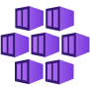



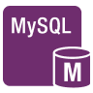






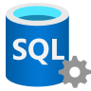














Platform tools
Resource Plane
Compute
Data
Networking
Services
Amazon EKS
Amazon S3
Route 53
Amazon SQS
Google Kubernetes Engine
Aiven
Cilium
Amazon Service Bus
Azure Kubernetes Service
PostgresSQL
Solo.io
Google PubSub
RDS MySQL
Cloudflare
Elasticsearch
Cluster Management
Cloud SQL
Envoy
Kafka
Rancher
Azure SQL
Cloud DNS
Azure Service Bus
Kubermatic
Redis
Azure DNS
Rafay
Mongo DB
Google Public DNS
Messaging
Ambassador
MariaDB
RabbitMQ
Capsule
MySQL
ActiveMQ

